Slide 1
Phrasal verbs
And past perfect tense

Slide 2
Word list
Do you like phrasal verbs?

Slide 3
Phrasal verbs
add up To make sense, seem reasonable
appeal to To plead or make a request / To be attractive or interesting
back down To withdraw, concede defeat
blow up To explode / To get angry
boil down to To be summarized as
call off To cancel
come across To find by chance / To appear, seem, make an impression
do without To manage without
drop off To deliver someone or something / To fall asleep

Slide 4
Phrasal verbs
ease off To reduce, become less severe or slow down (pain, traffic, work)
end in To finish in a certain way; result in
get at To imply
kick off To begin, start / to die
look up to To admire
own up To admit or confess something
shop around To compare prices
tell off To reprimand/criticize severely

Slide 5
Review
Have, should

Slide 6
Have/Should
Having __V3__(ed), I __V2__(ed)
Should he _____, I will _____.
Having done my homework, I went to bed.
Having lost the keys, she couldn’t come in.
Having missed the plane, he had to buy tickets for the next flight.
Should he call, tell him I’ll call back later.
Should you need any help, you can always phone me in the office.
Should you be late, we will start without you.

Slide 7
Grammar
Past Simple and Past Perfect

Slide 8
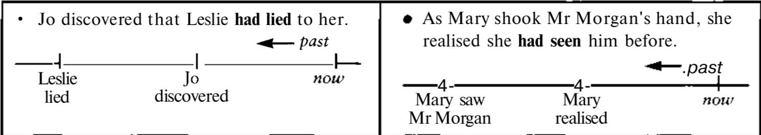
had done
We use the past perfect to talk about a past situation or activity that took place before another past situation or activity, or before a particular time in the past:

Slide 9
Let’s compare
When he stopped laughing, everyone left. (= they left after he stopped laughing)
When he stopped laughing, everyone had left. (= they left before he stopped laughing)
I got up when the phone rang. (= the phone rang and then I got up)
I had gone to bed when the phone rang. (= I went to bed and then the phone rang)

Slide 10
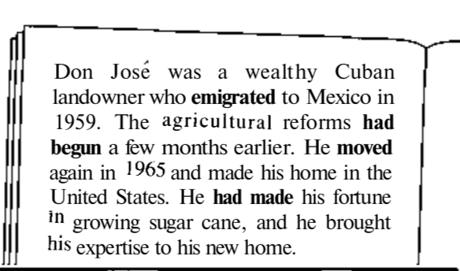
Example:
When we give an account of a sequence of past events, we usually put these events in chronological order with the past simple. If we want to refer to an event out of order - that is, it happened before the last event we have talked about - we use the past perfect.
Order of events:
1. Made fortune
2. Reforms began
3. Emigrated to Mexico
4. Moved to US
Order of account:
1. Emigrated to Mexico
2. Reforms had begun
3. Moved to US
4. Had made fortune

Slide 11
In addition:
We use the past perfect when we say what we wanted or hoped (etc.) to do, but didn't. Other verbs used like this include expect (to), mean (to), think (about + -ing).
I had wanted to visit the gallery before I left Florence, but it's closed on Sundays.
Bill had hoped to retire at 60, but they persuaded him to stay on for a few more years.

Slide 12
Word triggers
Normally:
I had done something by June.
before somebody did another thing
by the time something else happened
After Ivan (had) finished reading, he put out the light.
When Carol (had) brushed her teeth, she went to bed.
She became famous after she appeared on the TV programme.
When the teacher came in, all the children stood up.
The film had already begun by the time we got to the cinema.
She had just stepped into her office when the telephone rang.

Slide 13
Homework
Tell a story from your youth using there past simple and past perfect. (20+ sentences) Make 2 sentences with each word

